Slide 1
Email: cenef@co.ru; website: https://cenef-xxi.ru
Telegram: https://t.me/LowCarbonRussia
CENEf – XXI
Igor Bashmakov
Gaps between climate goals, policy ambitions and mitigation practices
We spend our energy to save yours!

Slide 2

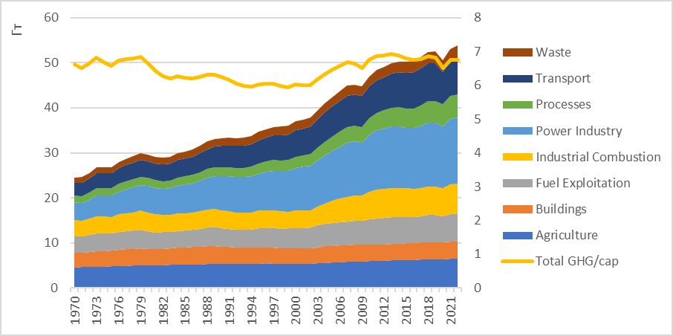
Gap with the 1.5ºC target is becoming wider. Manageable?
Global GHG emissions have not peaked yet: 1970-2022
Source: EDGAR database
LULUCF excluded

Slide 3
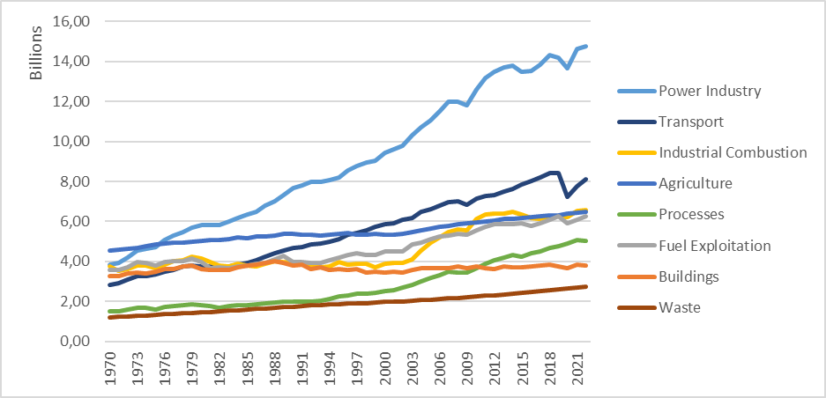
In some sectors, GHG emissions have not increased over several years: 1970-2022
In 2022, GHG emissions did not exceed:
2019 level in transport
2019 level in fuel production
1986 level in buildings
In 2015-2022, GHG emissions growth was 1% or less per year in:
agriculture
fuel energy use in industry
Source: EDGAR database

Slide 4

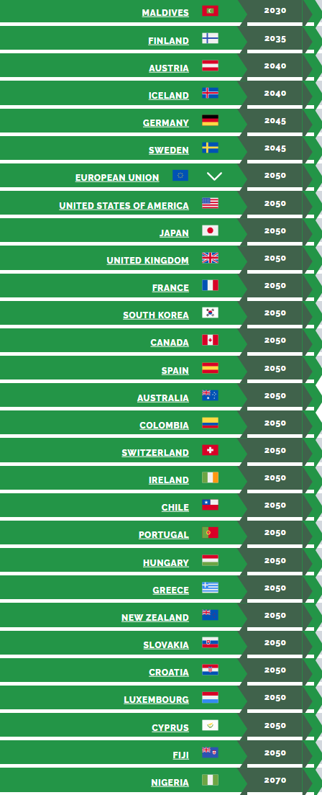
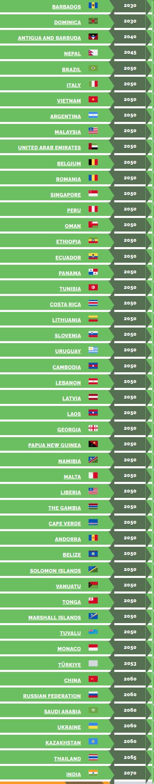
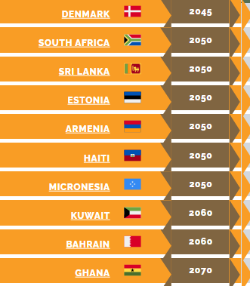
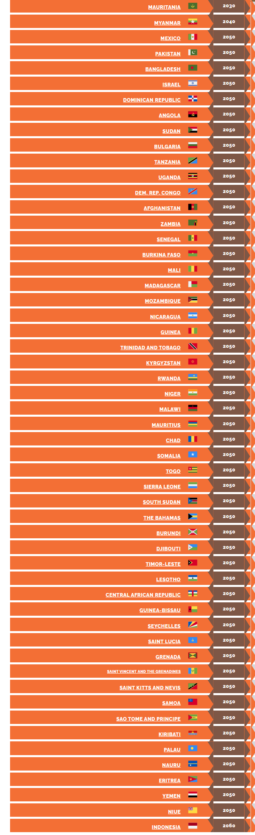
Carbon neutrality commitment. 168 countries

Slide 5
COP28. The Global Stocktake - the 1.5°C warming limit is at risk
Progress was too slow across all areas of climate action in:
  reducing greenhouse gas emissions
  strengthening resilience to a changing climate
  getting the financial and technological support to vulnerable nations
Next NDCs round. Countries are expected to:
  prepare their next round of NDCs in 2024-2025
  update their 2030 targets and present new, more ambitious targets for 2035 well ahead of COP30 in 2025.
COP28 calls for the UN to host a series of global and regional workshops and capacity-building sessions to help them
In 2025, the UN Secretary-General will:
  hold a special event for countries to submit their new commitments
  call on governments to speed up the transition away from fossil fuels to renewables such as wind and solar power in their next round of climate commitments

Slide 6
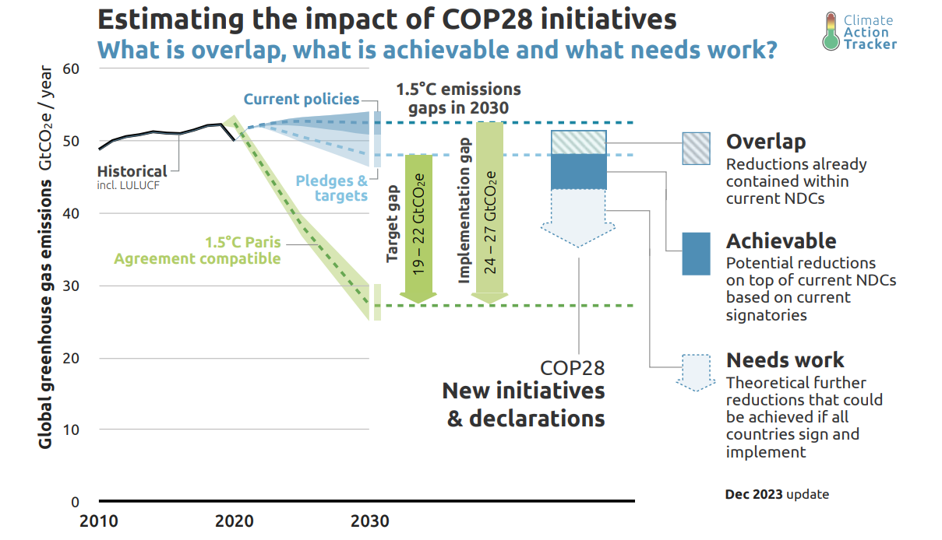

Emissions gaps for 2030 for 1.5ºC pathway
Chances to stay within the 1.5ºC warming threshold are fading away
Target gap – 19-22 GtCO₂eq
Implementation gap – 24-27 GtCO₂eq
COP28 pledges narrowed the gap by some
5 GtCO₂eq
If joined by all parties, it may be reduced by additional 6 GtCO₂eq
Source: COP28 initiatives will only reduce emissions if followed through - Dec 2023 (climateactiontracker.org)

Slide 7
Five IEA pillars to bridge the 1.5 °C gap by 2030
Triple global renewable power capacity
Double the rate of energy efficiency improvements
Commitments by the fossil fuel industry, and oil and gas companies in particular, to align activities with the Paris Agreement, starting by cutting methane emissions from operations by 75%
Establish large-scale financing mechanisms to triple clean energy investment in emerging and developing economies
Commit to measures that ensure an orderly decline in the use of fossil fuels, including an end to new approvals of unabated coal-fired power plants

Slide 8
COP28 energy related pledges
GLOBAL RENEWABLES AND ENERGY EFFICIENCY PLEDGE - triple RENs and double EE – signed by 130 parties
Global Methane Pledge (to cut methane emissions from oil and gas supply systems by at least 30 percent by 2030) - signed by 155 parties
GLOBAL COOLING PLEDGE (to cut GHG emissions from the cooling industry by 68% by 2050, increase the efficiency rate of air conditioning equipment by half by 2030, make a national plan for cooling, reduce a building's cooling load by more than 25%) - signed by 61 parties
Oil and Gas Decarbonization Charter (net-zero operations by 2050 at the latest; ending routine flaring by 2030; near-zero upstream methane emissions) - 50 companies, representing more than 40 percent of global oil production
The Carbon Management Challenge - target of reaching
1 GtCO2/year of CCS deployed by 2030 – signed by 21 parties
Net Zero Nuclear Industry Pledge (tripling nuclear capacity by 2050) – signed by 2 parties

Slide 9
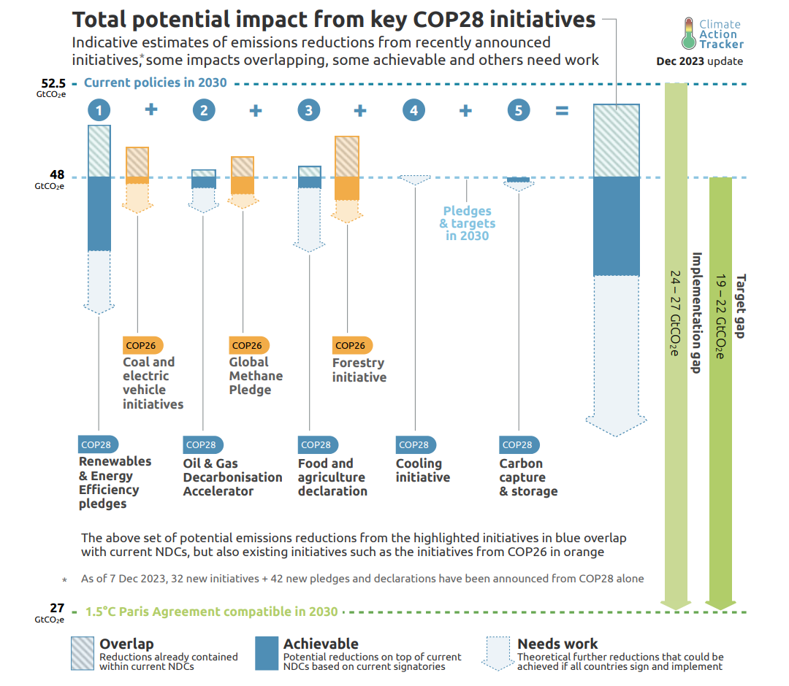
Contribution from COP28 initiatives to gaps narrowing
Source: COP28 initiatives will only reduce emissions if followed through - Dec 2023 (climateactiontracker.org)

Slide 10
Beginning of the end of the fossil fuel era
COP28 - “transition away from fossil fuels in energy systems, in a just, orderly and equitable manner, accelerating action in this critical decade, so as to achieve net zero by 2050 in keeping with the science” – signed by about 200 parties
Not yet a full “phase-out” for all, but … already for coal for G7.
G7 Ministers of Climate, Energy and the Environment met on 29-30 April, 2024, in Turin:
  phase out existing unabated coal power generation in our energy systems during the first half of 2030s or in a timeline consistent with keeping a limit of 1.5°C temperature rise within reach, in line with countries’ net-zero pathways
  commitment to achieving a fully or predominantly decarbonized power sector by 2035
  operationalizing our contribution to the global transition away from fossil fuels in energy systems, through the development and implementation of domestic plans, policies and actions, including to inform and be reflected in our NDCs and LTSs, and call on others, particularly other major economies, to act likewise

Slide 11
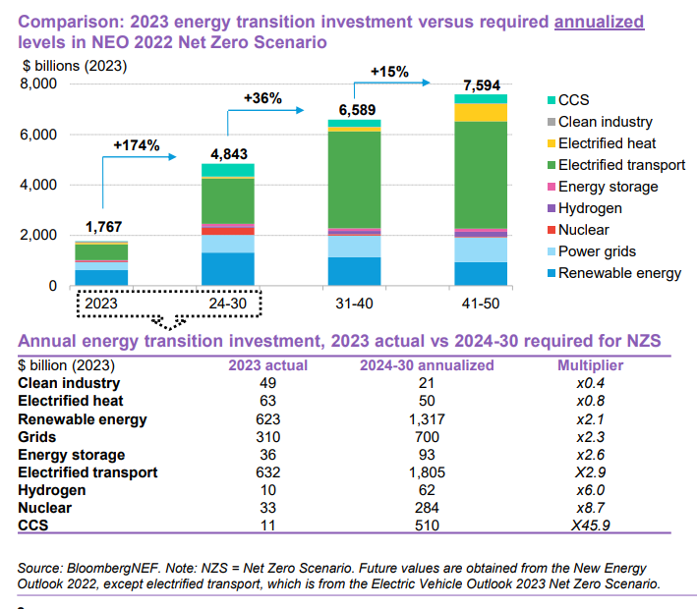
Investment gap. BNEF Net Zero scenario requires nearly tripling of investment in 2024-2030
Extra €406bn needed annually to hit EU’s 2030 climate target:
Extra €406bn needed annually to hit EU’s 2030 climate target: report – Euractiv

Slide 12
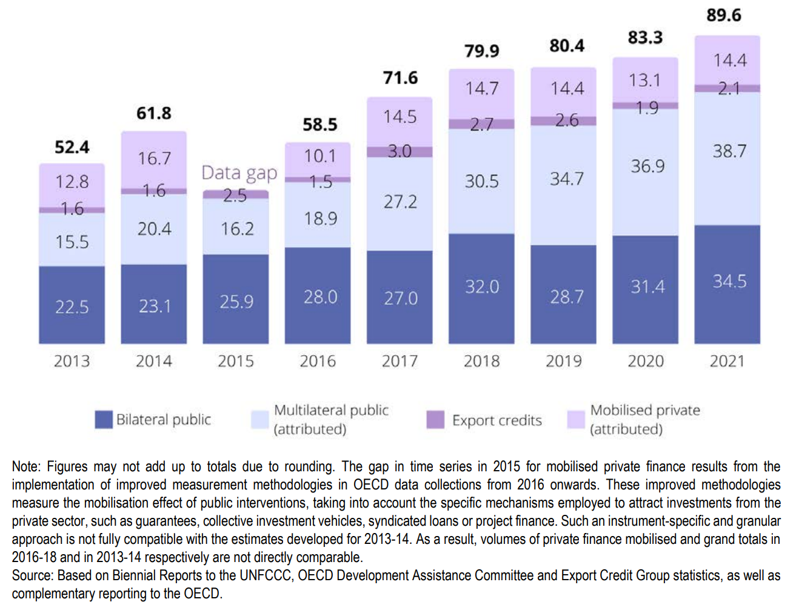
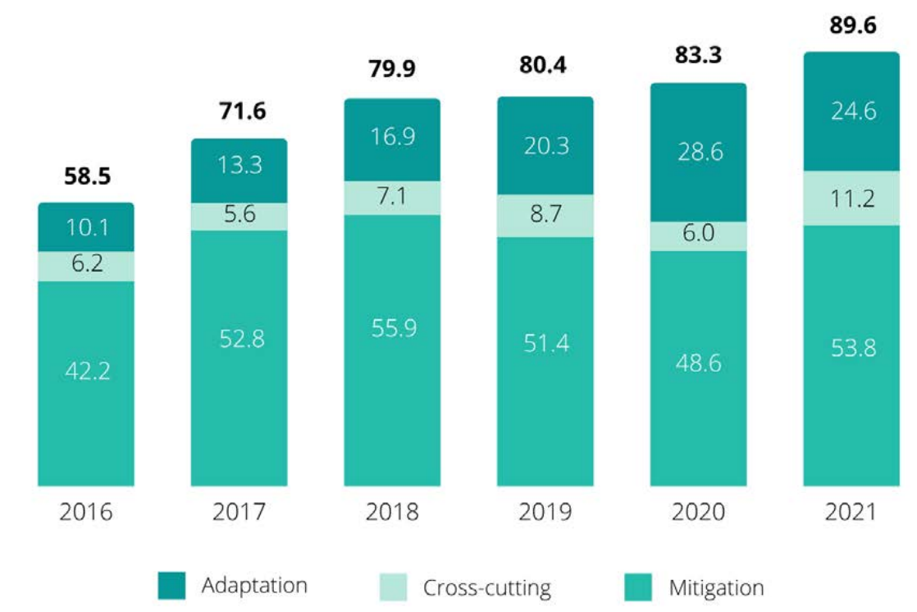
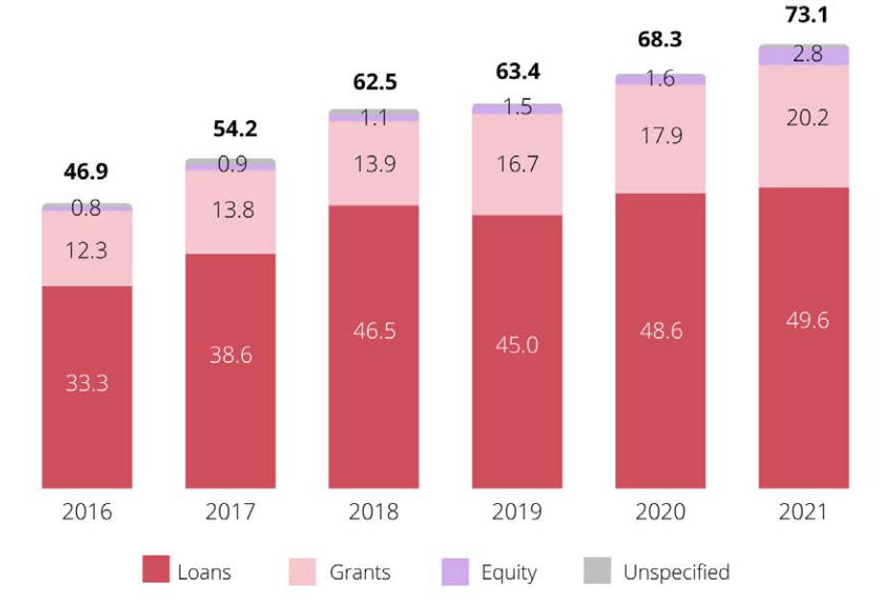
The gap to mobilize US$100 is closed. In 2022, total volume of climate finance provided and mobilized by developed countries for developing countries reached US$100 billion
100
2022
Goals
Forms
G7-Climate-Energy-Environment-Ministerial-Communique_Final.pdf (g7italy.it)

Slide 13
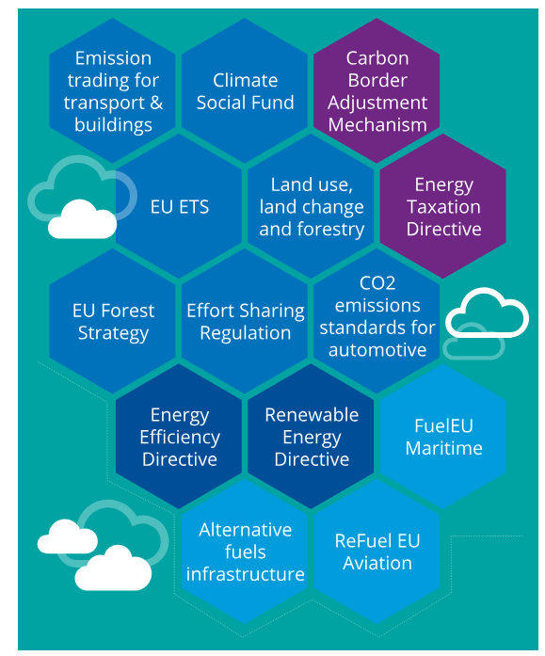
Equity and distributional effects assessment gap for extensive and complex climate regulation
Key regulations and programmes in the EU within the framework
of “Fit for 55”. Very complex system and no impacts assessment
30 laws are guiding EU to become climate-neutral

Slide 14
Missed dimension – equity and just transition
Assessments of how climate policies will affect the costs and who will benefit from these policies, how proportionately the burden is shouldered, are important to mobilize support
“Fairness is not about everybody getting an equal share; it is about everyone by right getting an unequal share” (A. Gelman)
Robust public engagement and participation are critical. Different concepts of equity can be used:
  distributive (fair distribution of costs and benefits across groups with different incomes or among regions)
  procedural (ensuring both the possibility of participation and the account of the views of different groups in decision-making processes)
  recognitional (fair representation guarantees for under-recognized groups)
Insufficient attention to long-term sustainability issues in the 2030 Agenda, which includes 17 SDGs, and a high level of ambition over a short time frame have resulted in only 15% of the 169 SDG-subtargets being on track.
Distribution_effects_eng_1134bab18f.pdf (cenef-xxi.ru)

Slide 15
Perception gap. Farmer protests in the EU and climate policy
Energy crisis – Russian military operation
Rising prices for fuel and electricity
Growing prices for fertilizers (primarily nitrogen)
Restrictions on the use of nitrogen fertilizers
Reducing subsidies for activities with high GHG emissions
Low food prices among competitors
Demanding increased subsidies for protection against extreme weather events, including droughts
Demand for increased spending on flood protection
Climate policies
Request to compensate losses from climate change
Many regulatory measures are not related to climate – biodiversity conservation, food safety, etc., but associated with climate policy
Analysis: How do the EU farmer protests relate to climate change? - Carbon Brief

Slide 16
Holistic approach gap. “The seven matrices method”
One important problem is the lack of assessment of the potential impact a climate policy may have on the economic agents and their ability to consolidate–formally or informally–by using a variety of institutes to promote or, on the contrary, stand up against these policies.
Resistance from the fuel lobby.
Distributional effects
Institutions and policies acceptance
Policies architecture
Scenarios
Projections
Positioning in global economy
Geopolitical effects
Distribution_effects_eng_1134bab18f.pdf (cenef-xxi.ru)

Slide 17
Not just carbon pricing. Three domains of low carbon policies
There are three basic models of making investment- and management decisions
The need for strategic decisions emerges when the existing technological and management systems run into the “limits of growth” or “limits of change”.
A set of low carbon policies should foster the required change in the first two decision-making models and lay a basis to launch the third model.
move technology frontier
make competitive
put in focus
roadmaps_c702871b52.pdf (cenef-xxi.ru)

Slide 18





Five pillars for successful mitigation policies implementation
Technologies – availability of a wide variety of technologies and equipment for GHG mitigation in all sectors
Regulations and programmes – mandatory requirements that allow for policies and coordinated action to achieve the targets as specified in the national strategies and programmes
Incentives and financing – measures aiming to improve the economic attractiveness of low carbon technologies and to provide access to financing which is essential to comply with regulations and attain the targets
Institutes – organizations that are authorized to launch and coordinate decarbonization processes and are responsible for the results, and agencies that represent low carbon transition stakeholders
Human capital – a sufficient number of experts with adequate training who are engaged in policy development, organization and implementation of low carbon transition; supplying these experts with knowledge, information, and tools for decision-making
roadmaps_c702871b52.pdf (cenef-xxi.ru)

Slide 19
Technological gaps and drift of energy security focus
technology readiness level gap – lack of affordable low-carbon technologies with a high level of technology readiness
supply gap – lack of technologies, installation and operation capacities in the markets at a scale sufficient to move along the traced pathways to carbon neutrality
localization gap – lack of self-sufficiency in equipment and critical materials production to mitigate the risks of potential interruptions in equipment imports, or the risks of monopolistic abuses in these markets by dominant suppliers, similar to what has been seen in fossil fuel markets for decades
New geopolitical concerns on energy security and competitiveness are drifting away from fossil fuels supply towards low carbon technologies and critical materials supply
OPEC+ and other fossil fuel suppliers are drifting to the shadow of China dominance in low carbon technologies. Critical Minerals Security Program. "New European Competitiveness Deal" -
Promoting supply chain diversification, transparency and traceability

Slide 20
Energy transition is not easy
Phasing-out combustion engine and residential gas boilers are under fire
People are dissatisfied with the work of EU institutions and national and local agencies, and more than two thirds believe that the views and ideas of citizens are not taken seriously by political leaders. News (eceee.org)
The powerful cohort of state-controlled corporations and shareholder-owned multinationals are driving the climate crisis and impeding the solutions
75 European organisations call for sufficiency policies to be urgently integrated as a cornerstone in the new EU strategic agenda. News (eceee.org)
Reporting requirements are too tough for companies. Businesses call on to “concentrate on the essentials” News (eceee.org)
Environmental groups protest against phasing in new capacities to produce critical materials (opposition to Tesla’s Gigafactory expansion plans)
If Donald Trump is elected, it ‘could put the world’s climate goals at risk’. Pre-election speculations on Green Deal

Slide 21
Agenda for COP29. “Financial” COP
Turn legal acts into practice
Enhance ambition and enable action. Early submission of new, high-ambition NDCs
Inclusive process for inclusive outcomes
Decisions on Article 6 –
  Tools to assess risks of leakage, permanence of removals and safeguards
  A registry for carbon credits from the centralized U.N. crediting mechanism
Go beyond the 100 US$ billion - establish innovative sources of finance
‘Roadmap to Mission 1.5°C’ to “significantly enhance international cooperation and the international enabling environment to stimulate ambition in the next round of nationally determined contributions, with a view to enhancing action and implementation over this critical decade and keeping 1.5°C within reach.”

Slide 22
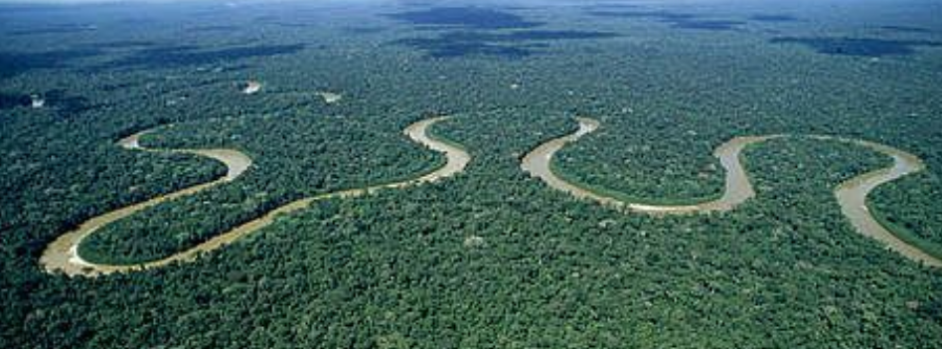
Agenda for COP30. “Natural Solutions” COP
New NDCs. Countries are expected to update their 2030 targets and present new targets for 2035
LULUCF in focus
Promoting financial mechanisms in conservation (non-carbon) themes, with a particular focus on tropical forests
Financial Architecture Reforms. Significantly scale up climate change adaptation and mitigation investments in an equitable manner
Climate justice agenda
Inclusive mitigation and adaptation policies and Sustainable Development

Slide 23
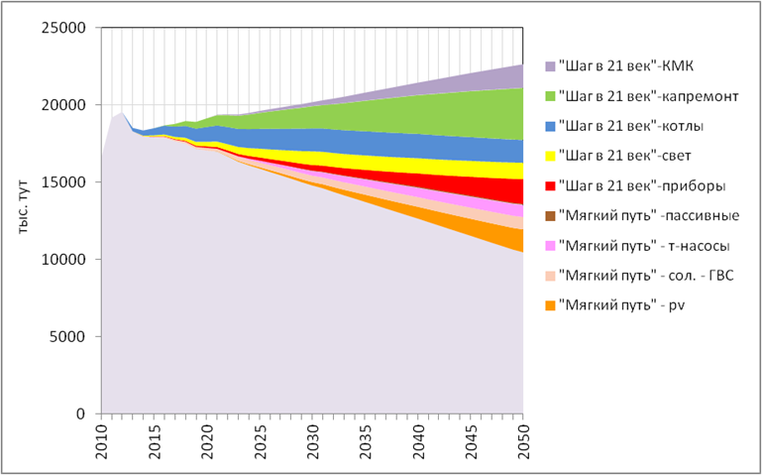
CENEf in 2013 prepared energy efficiency program, fo building in Uzbekistan
Impacts of individual integrated energy efficiency and renewable energy development measures on the dynamics of residential natural gas consumption in the “Soft way” scenario
Contribution of individual integrated measures to the evolution of GHG emissions in the residential sector

Slide 24
«Будущее еще нигде не написано»
«The future isn’t written yet».
Movie «Back to the Future»
«Будущее не написано. Оно скрыто в выборе, который вы делаете. Наше будущее определять нам. Всегда».
«The future is not written. It lies in the choices you make. Our future is ours to decide. Always».
Матт Миклуш «Jack Black and Imagine Nations»
Нельзя увидеть будущее, повернувшись к нему спиной!
You can't see the future if you turn your back to it! Author
Нельзя отдавать будущее в руки тех, кто живет прошлым.
The future cannot be given into the hands of those who live in the past. Author

Slide 25
Email: cenef@co.ru; website: https://cenef-xxi.ru
Телеграмм-канал channel https://t.me/LowCarbonRussia
ЦЭНЭФ – XXI век
И.А. Башмаков
Спасибо за внимание и понимание!
Центр энергоэффективности – XXI век (ЦЭНЭФ-XXI)
Мы тратим свою энергию, чтобы экономить вашу!

