Slide 1
Международная лаборатория исследований проблем устойчивого развития ИПЭИ
Low-carbon development: a driver or a brake on economic growth?
Potashnikov V. e-mail: potashnikov.vu@gmail.com
Notes:
1

Slide 2
GLOBAL DEMAND FOR FOSSIL FUEL
There are for main effects:
Replacing fossil fuel-based electricity with solar and wind power New renewable capacity was higher than from fossil fuel from 2012 (except 2014) (IRENA)
Electric cars displace the rest Electricity is generated from renewable and natural gas & coal. Coal & gas are cheaper than oil. Average fossil fuel consumption by an electric car in current conditions is less than oil ones (fossil fuel consumption by electric car in EU 43-90 MJ/100km, in China 149 MJ/100km vs. 164-327 MJ/100km by oil car)
Global efforts to prevent climate change (ex. EU Green deal)
Global population growth (plus 1.5 bln. to 2050, mainly by Sub-Saharan Africa) and industrialization
As a result, global demand for fossil fuels may increase or decrease
But demand from the EU and China (important countries for Russia) should decline due to these effects and negative demographics
Notes:
https://www.irena.org/newsroom/pressreleases/2019/Apr/Renewable-Energy-Now-Accounts-for-a-Third-of-Global-Power-Capacity

Slide 3
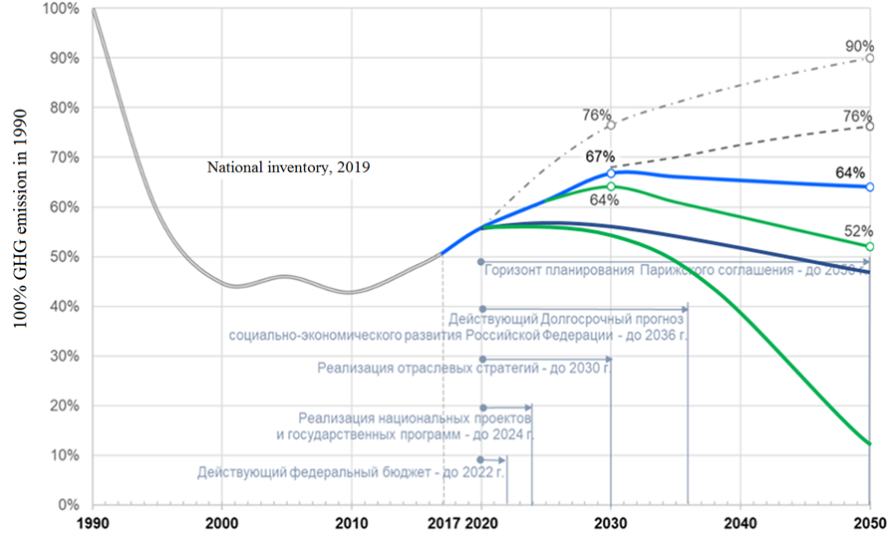
What about Russia
Low ambitions about: Renewable, Decarbonization, electric vehicle
There is plan of gray hydrogen export (about 2 Mt by 2035)
BAU, gov.
Inertia scenario, gov.
DDP, gov.
DDP intens., gov.
BAU, RANEPA (CO2 only)
DDP, RANEPA (CO2 only)
*DDP – deep decarbonization scenario, BAU – business as usual

Slide 4
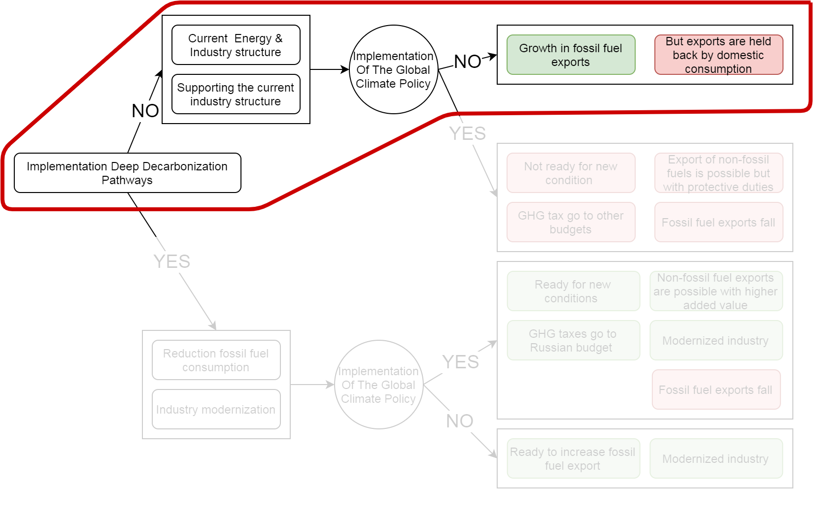
Possible costs of Russian energy policy

Slide 5
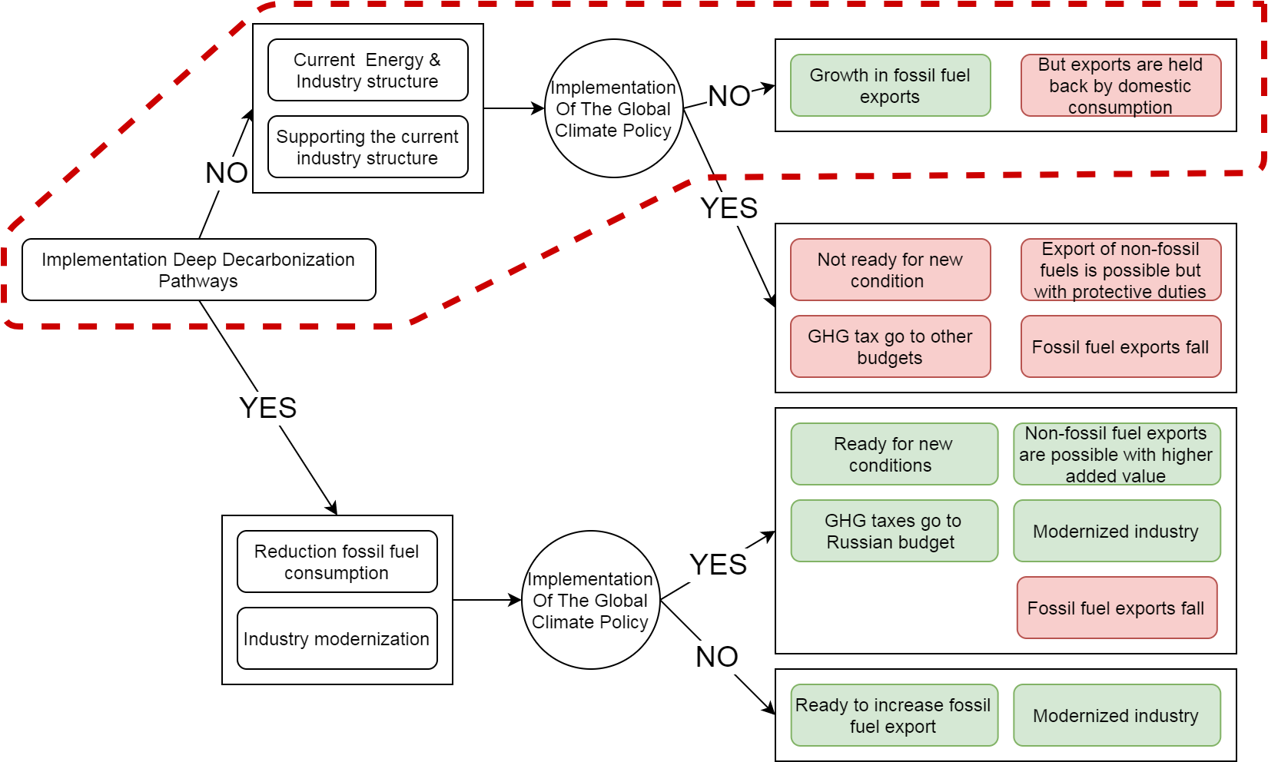
Possible costs of Russian energy policy
What about economic growth?

Slide 6
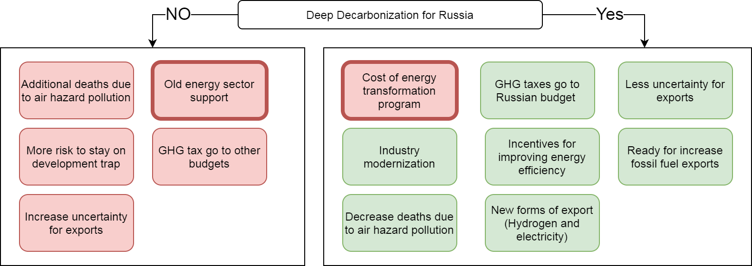
Possible costs of Russian energy policy
What about economic growth?

Slide 7
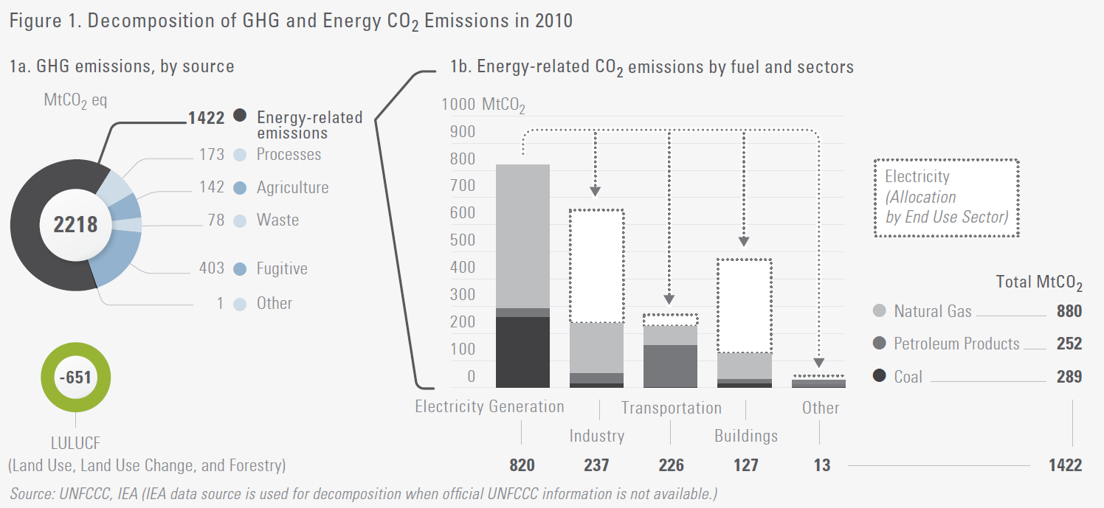
Source of decarbonization:
*DDPP, 2014

Slide 8
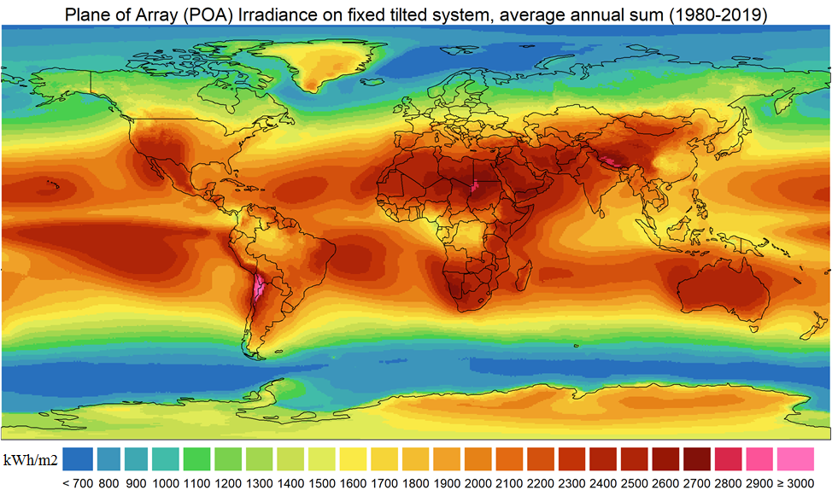
MERRA 2 NASA

Slide 9
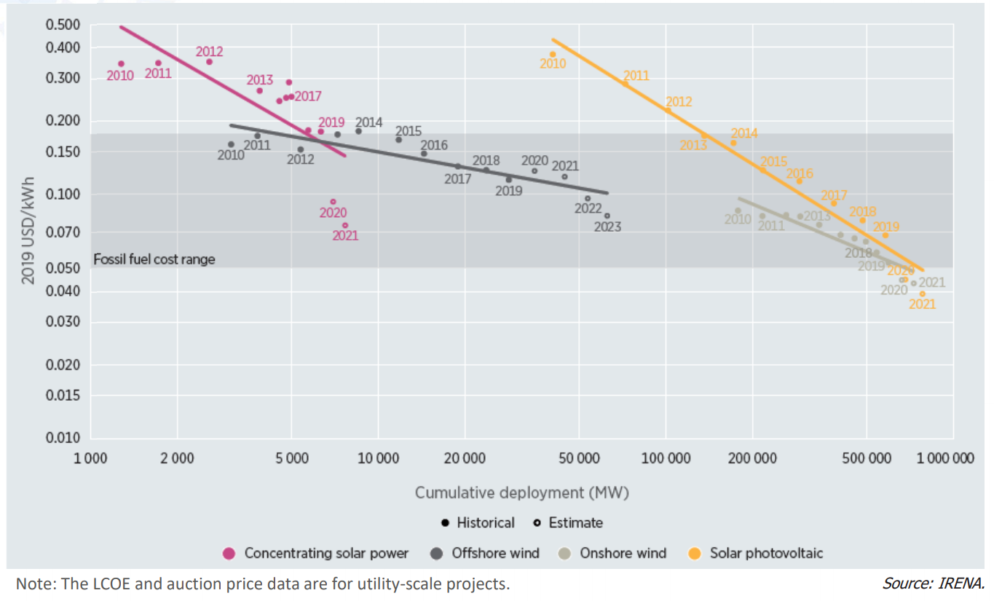
Electricity generation costs

Slide 10
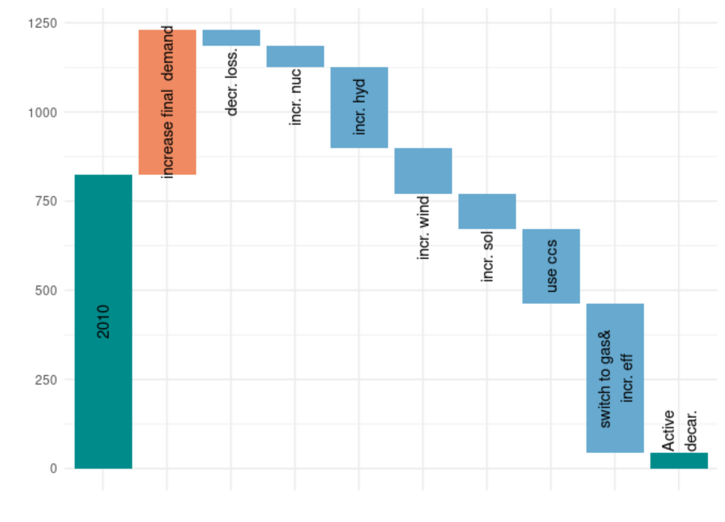
Electricity decarbonization
Safonov, Potashnikov, et. All 2020

Slide 11
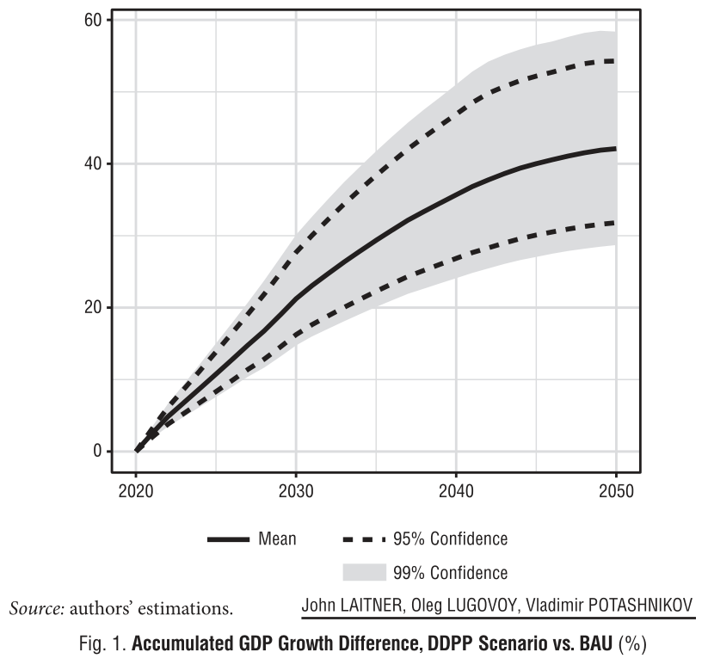
Cost of decarbonization
Use RUTIMES (RES) results for IO analysis
Direct multiplicative effect of higher investment demand and future lower energy spending
Productivity growth effect
Laitner et al, 2020

Slide 12
Thank you for your attention!
Международная лаборатория исследований проблем устойчивого развития ИПЭИ

Slide 13
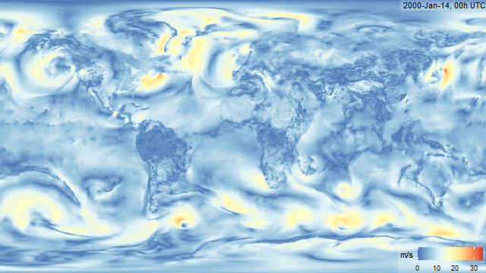
MERRA 2 NASA

